Slide 1
Output Primitives
Nazmun Nessa Moon
Assistant Professor

Slide 2
Output Primitives
Output Primitives: Basic geometric structures (points, straight line segment, circles and other conic sections, quadric surfaces, spline curve and surfaces, polygon color areas, and character strings)
These picture components are often defined in a continuous space.

Slide 3
Output Primitives
In order to draw the primitive objects, one has to first scan convert the object.
Scan convert: Refers to be operation of finding out the location of pixels to the intensified and then setting the values of corresponding bits, in the graphic memory, to the desired intensity code.

Slide 4
Output Primitives
Each pixel on the display surface has a finite size depending on the screen resolution and hence a pixel cannot represent a single mathematical point.

Slide 5


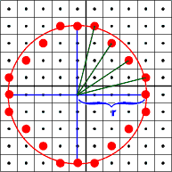
Circle Generation Algorithms
The equation of a circle:
We could solve for y in terms of x

Slide 6
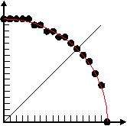
Circle Generation Algorithms
The spacing between plotted pixel positions is not uniform.

Slide 7
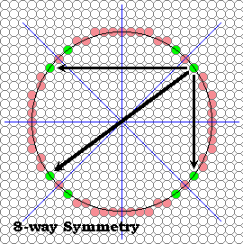
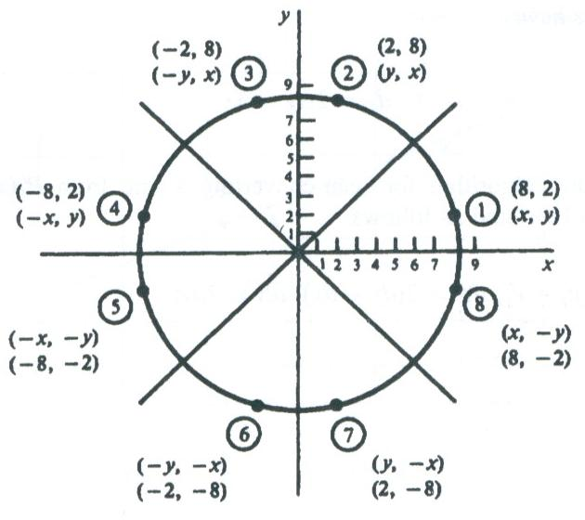
Circle Generation Algorithms
Computation can be reduced by considering the symmetry of circles
8 -Way symmetry

Slide 8
Midpoint Circle Algorithm

Slide 9
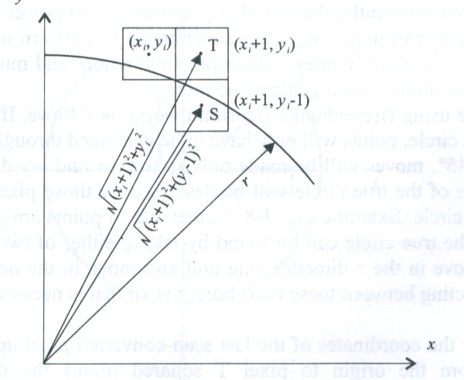
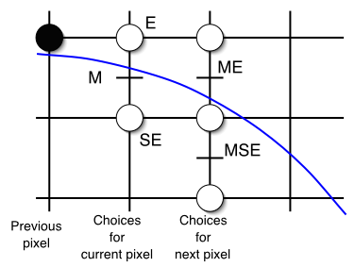
Circle Generation Algorithms
As in the line algorithm, we sample at unit intervals and determine the closet pixel position to the circle path at each step.

Slide 10
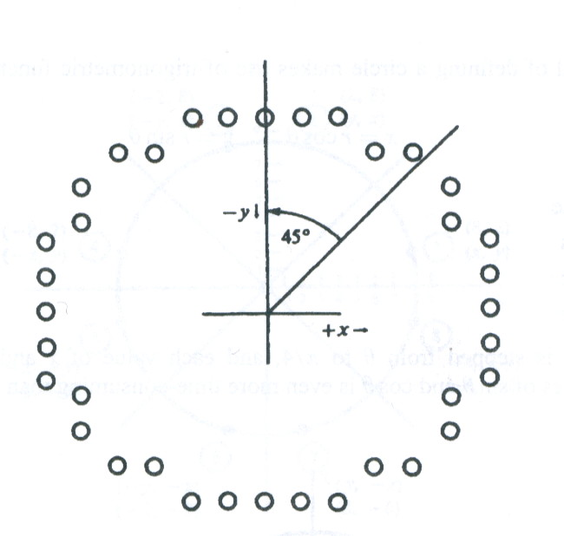
Circle Generation Algorithms
Points are generated from 90º to 45º, moves will be made only in the +x and –y direction.
positive x direction over this octant and use a decision parameter

Slide 11
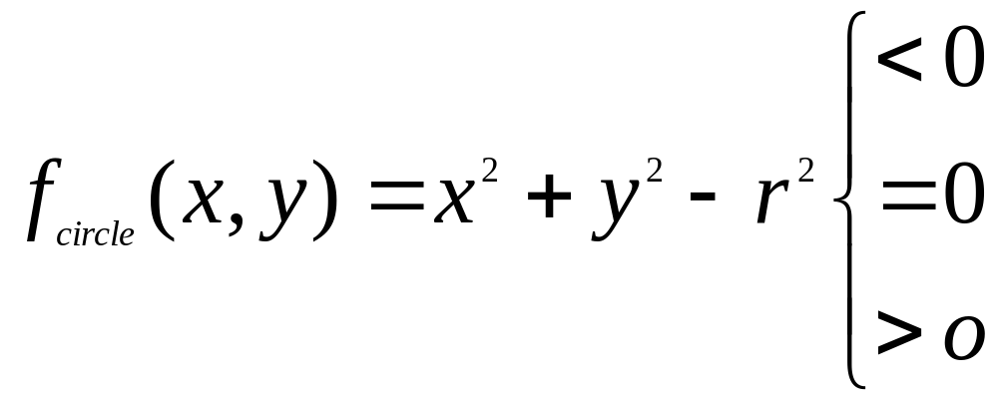
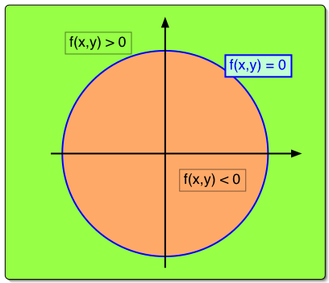
Circle Generation Algorithms
We define a circle function:

Slide 12
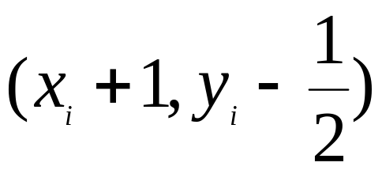
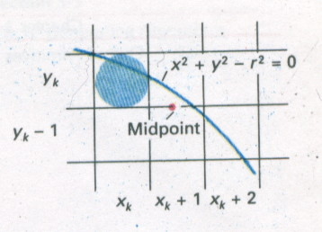
Circle Generation Algorithms
Midpoint
Consider the coordinates of the point halfway between pixel T and pixel S
Midpoint

Slide 13
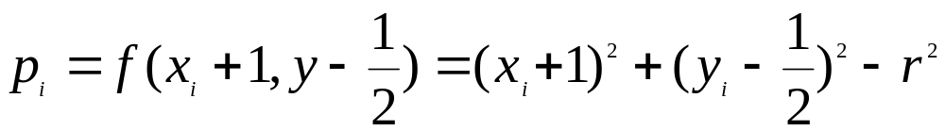
Circle Generation Algorithms
We use it to define a decision parameter

Slide 14
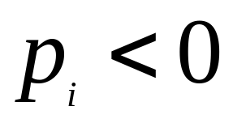
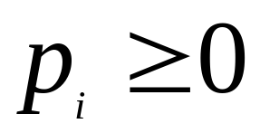
Circle Generation Algorithms
If is negative, the midpoint is inside the pixel, and we choose pixel T.
If we choose pixel S.

Slide 15
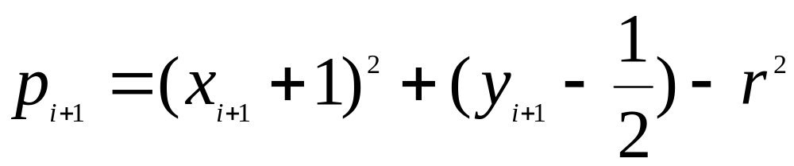
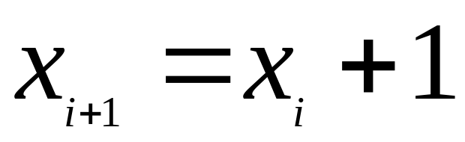
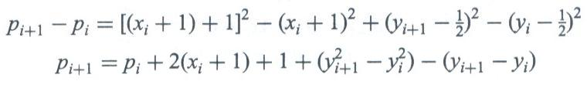
Circle Generation Algorithms
Parameter for the next step is:
since

Slide 16


Circle Generation Algorithms
If T is chosen ( ) we have:
If pixel S is chosen ( ) we have

Slide 17

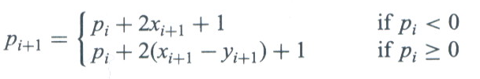
Circle Generation Algorithms
In terms of

Slide 18



Circle Generation Algorithms
Initial value for the decision parameter using the original function of (0,r(
When r is an integer we can simply set

Slide 19
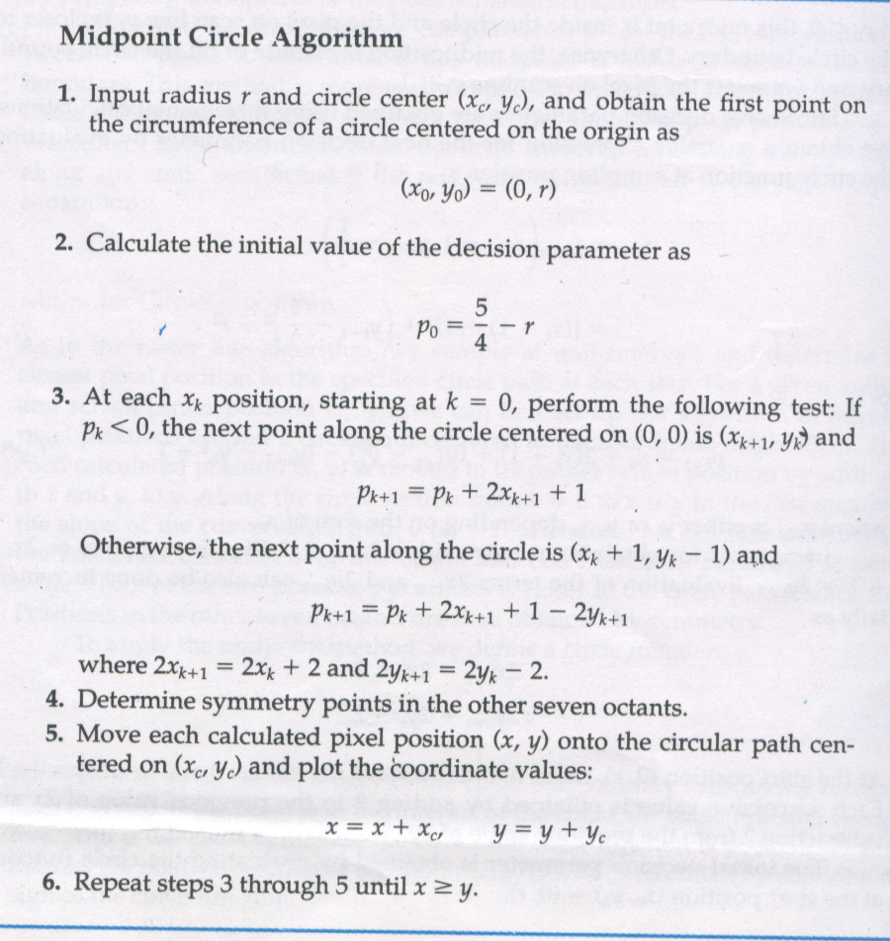
Circle Generation Algorithms

Slide 20
Circle Generation Algorithms
int x = 0;
int y = radius; int p = 1 - radius;
circlePoints(xCenter, yCenter, x, y, pix);
while (x < y) {
x++;
if (p < 0) {
p += 2*x+1;
} else {
y--;
p += 2*(x-y+1);
}
circlePoints(xCenter, yCenter, x, y, pix);
}

Slide 21
Circle Generation Algorithms
Example: A circle radius r=10
x=0 to x=y
P₀=1-r = -9

Slide 22
Exercises?

